Slide 1
HOW TO DISSECT A CODING ABSTRACT
AKA – How the heck do
I do this???

Slide 2
EACH CASE IS DIFFERENT…
And yet coding process is essentially the same.
Coding is like being a detective!
Your clinical knowledge and organization of data is important to your success.

Slide 3
SO MANY DOCUMENTS, SO LITTLE TIME!
Know which documents you may code from.
Who has the final decision in a complex case regarding the final diagnosis.
What documentation you may use in coding the encounter.

Slide 4
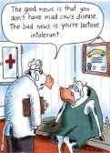
HAVING A PLAN OF ATTACK IS THE KEY!
What should you look at first?
Think, why was the patient here???

Slide 5
A Review of a Case Scenarios
The patient was admitted for takedown of colostomy. The patient underwent a colostomy 3 months ago after colon resection was performed for perforated diverticulitis. The patient was taken to the OR for colostomy reversal with end to end anastomosis. Final diagnosis Perforated diverticulitis Procedure Colostomy Takedown

Slide 6
FOLLOW THE YELLOW BRICK ROAD!
Admission for colostomy takedown
ABSTRACT
cc
H/P INFO
What will you code?
Hx Perforated Diverticula Status Post Colosomy Residual Diverticula

Slide 7
CODE WHAT IS CLINICALLY RELEVANT!
PDX – Admission for Colostomy Takedown
Secondary DX:
-Diverticula, large intestine
Principal Procedure – Takedown Colostomy

Slide 8
Coding is much like telling a story!
My review of codes should tell me this about the patient:
Principal reason the patient was admitted.
What other conditions are being monitored, medicated, assessed, and/or treated.
What services and procedures were performed.

Slide 9
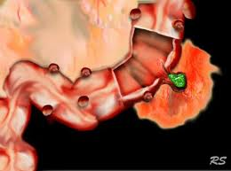
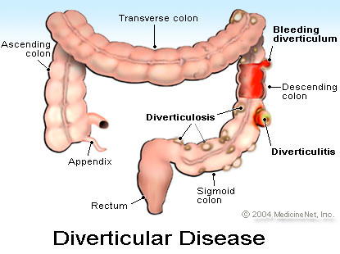
So, why don’t I code perforated diverticulitis???
The patient was admitted for takedown of colostomy. The patient underwent a colostomy 3 months ago after colon resection was performed for perforated diverticulitis. The patient was taken to the OR for colostomy reversal with end to end anastomosis. Final diagnosis Perforated diverticulitis Procedure Colostomy Takedown
Historical Condition
Current Condition

Slide 10
AND THAT, IS THE PROBLEM WITH PHYSICIAN DOCUMENTATION!
Ok, so what the heck was
the PDX anyway???

Slide 11
Case Scenario
The patient was admitted with abdominal pain in the RUQ. Workup included an EGD that showed some mild erosive gastritis and abdominal ultrasound was positive for gallstones.
PDX – Abdominal pain due to gastritis versus cholelithiasis. Procedure EGD with biopsy of the esophagus.
Think!
What is the CC?
What was found on workup?
What is the documented PDX?
What procedures were performed?

Slide 12
Dissecting the abstract!
The patient was admitted with abdominal pain in the RUQ.
Chief Complaint
Workup included an EGD that showed some mild erosive gastritis and abdominal ultrasound was positive for gallstones.
Clinically
Relevant!
PDX – Abdominal pain due to gastritis versus cholilithiasis.
PDX What are the guidelines for comparative and contrasting diagnoses?
Procedure EGD with biopsy of the esophagus.

Slide 13
POA
The problem for coders;
Did they have it when they walked in the door???
Gee, maybe I should document it was POA?

Slide 14
HOW TO KNOW???
Look for medications to treat on admission.
Look at lab values on day of admission.
Keep notes as you code based on the document type.
CC – from ER record or from H/P
POA DX – Review H/P
Scan for all conditions present at the time the order for admission was written.

Slide 15
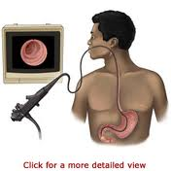
What about the EGD???
Esophagogastroduodenoscopy - EGD
Service mandates scope is inserted to duodenum
Biopsy was up in esophagus???

Slide 16
IN ICD-9-CM
EGD with Biopsy – only one code for both the EGD and the biopsy regardless of location.

